Slide 1

E6893 Big Data Analytics:
Geographic and Financial Impact of Carbon Tax in the United States
Team Members: Keir Lauritzen (kcl2143)
Adam Owens (ao2595)
Kosta Andoni (ka2604)
December 14, 2016
1

Slide 2
Overview
Carbon taxes have been proposed to address climate change
Washington State’s Initiative 732 called for $100 per ton¹
IEA suggests $125 to $140 per ton²
Financial cost of carbon tax will vary geographically
Commuters who travel long distances for work in cities will have higher costs
Generally, incomes vary as you move away from city centers
Cost relative to income may fall disproportionately on certain areas.
Challenging to find solutions (you cannot move most houses)
City: $$$/$
Suburbs: $$
Exurbs: $
Understanding distribution of costs helps illuminate likelihood of any potential implementation (in future)
2

Slide 3

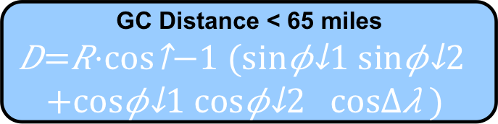
Data Set Gathering
ZCTAs
Metros Areas
111,727 Routes in JSON
Driving distance, traffic, driving time
33120 Total
26170 Connect
3592 Total
497 Pop > 50k
Commuter assumptions:
25% of people commute
No one commutes > 65 miles
Commuting a split between cities by size of the city
GC Distance < 65 miles
$$D=R⋅\cos^{−1}{(\sin{φ_{1}\sin{φ_{2}}}+\cos{φ_{1}\cos{φ_{2}}}\cos{Δλ})}$$
Financial Data:
Poverty Rates
Median Income
Limited to 125,000 req/year (50,000 req/day) on an ed. acnt
111,727 Routes in JSON
Driving distance, traffic, driving time
Analysis
ZCTA = Zip-Code Tabulated Area, Census bureau designation that mostly aligns with actual zip codes
3

Slide 4
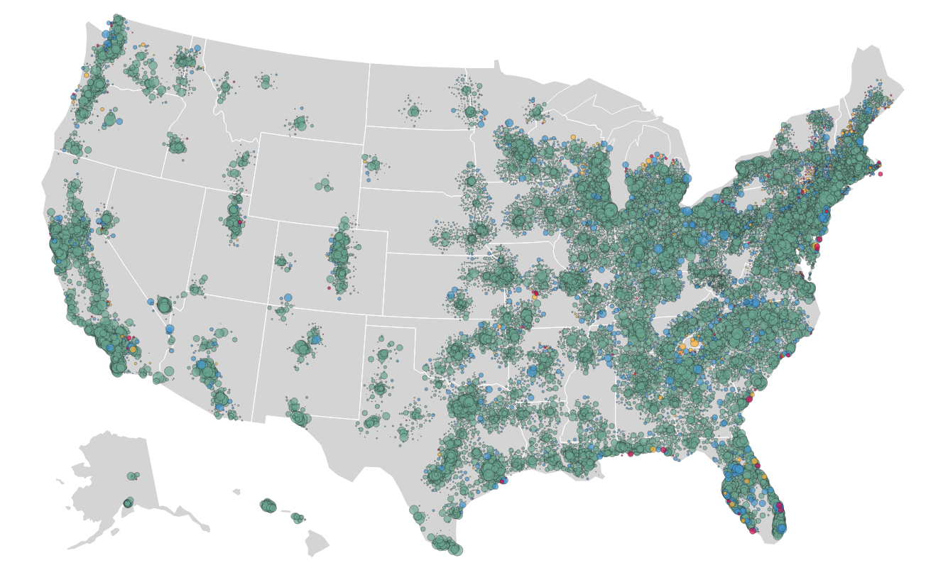
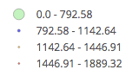
Estimated Carbon Tax from Commuting
<$793 | <5.7 T
<$1143 | <8.2 T
<$1447 | <10.3 T
<$1889 | <13.5 T
4

Slide 5
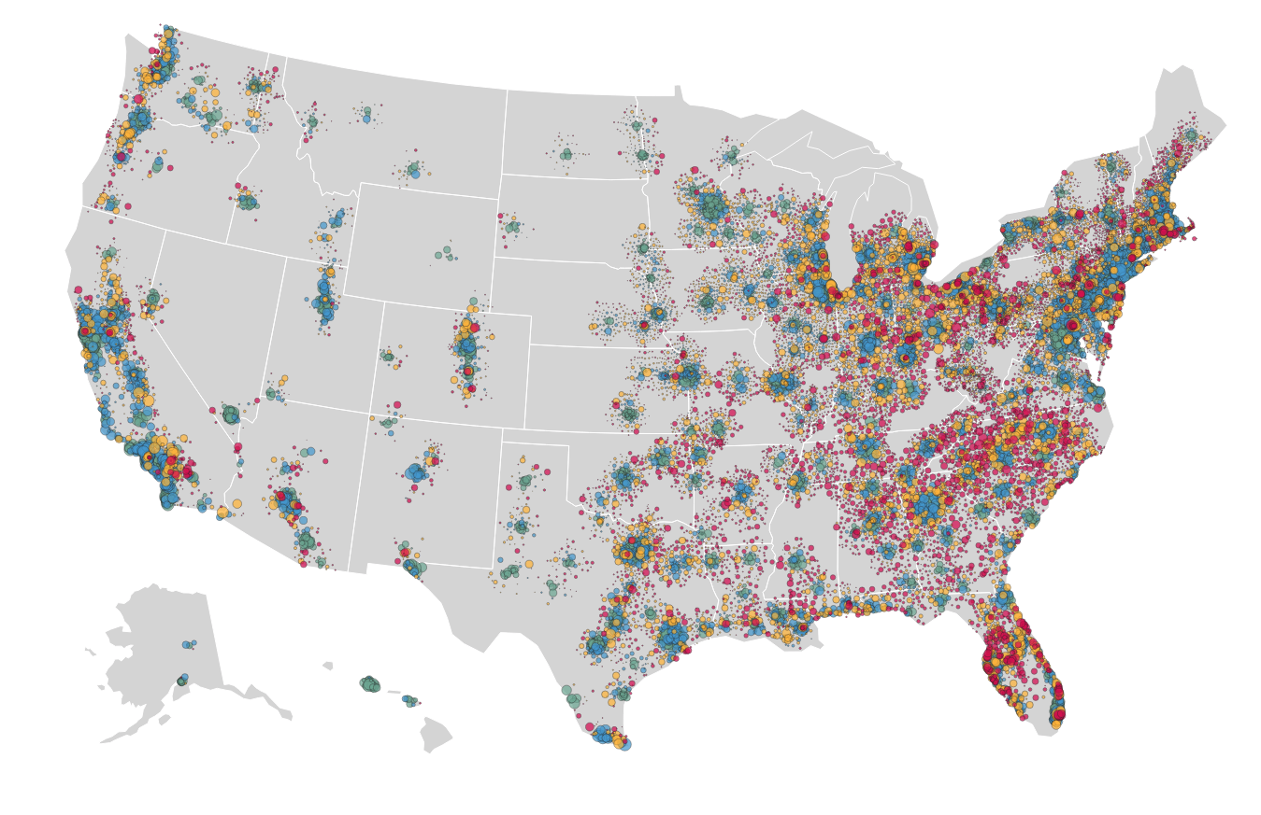
Carbon Tax as Percentage of Income
<0.53%
<0.94%
<1.51%
>1.51%
Different story nationwide!
5

Slide 6
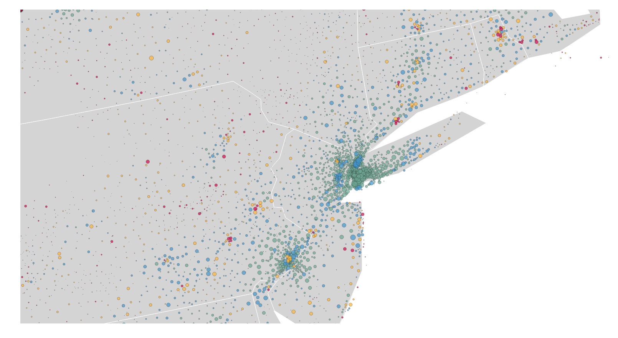
Carbon Tax as Percentage of Income
<0.53%
<0.94%
<1.51%
>1.51%
Not really an NYC Problem…
6

Slide 7
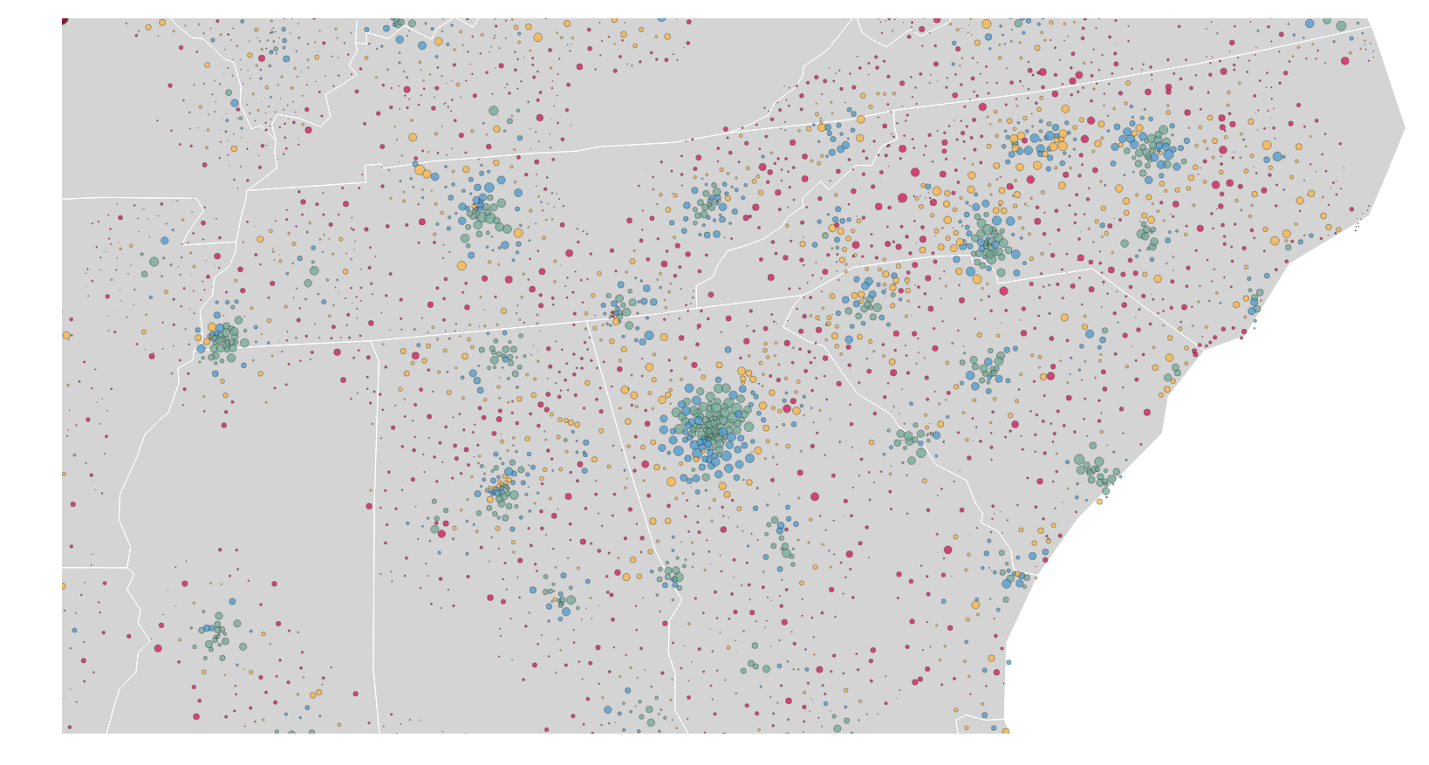
Carbon Tax as Percentage of Income
<0.53%
<0.94%
<1.51%
>1.51%
Especially in the South.
7

Slide 8
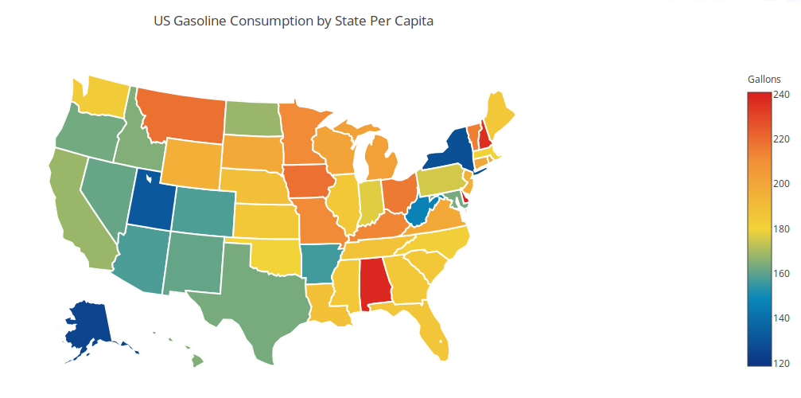
Model Validation: Alternative source
Lower in West
Higher in upper Midwest
Hotspots align
8

Slide 9
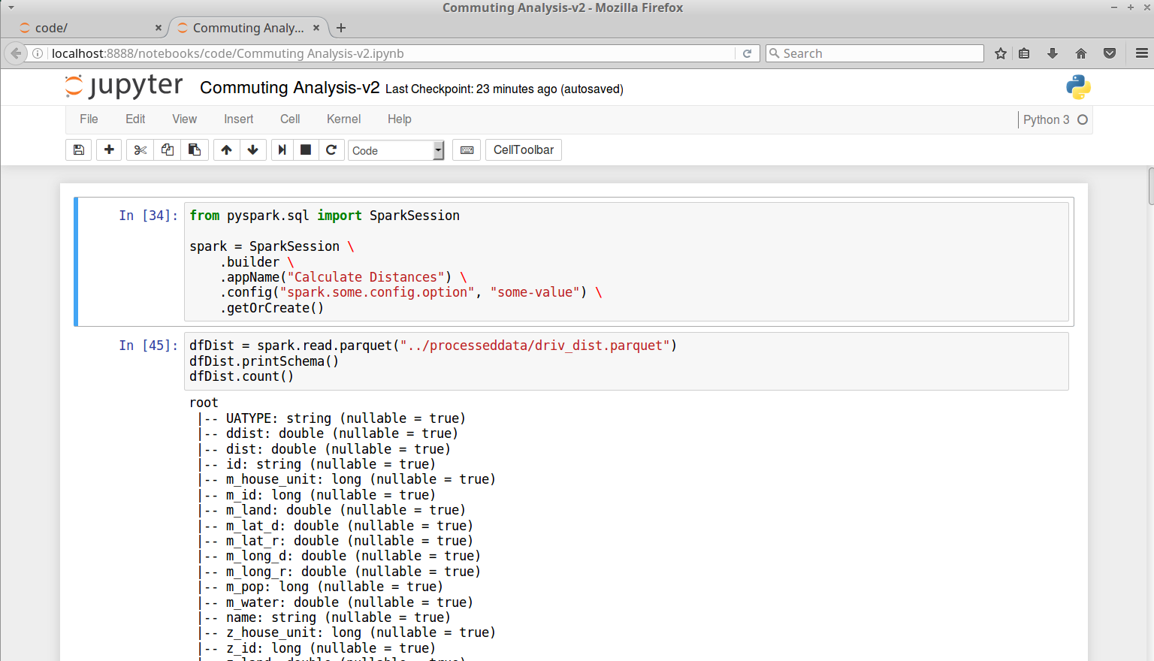
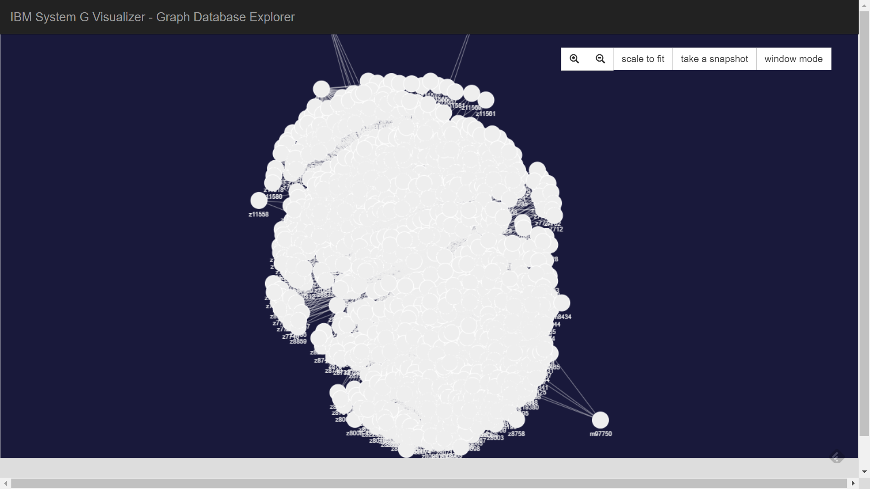
Technology
Route Data: Bing Maps
Main tools: PySpark/SparkSQL, Jupyter Notebook
Visualization tools: Plotly, System G
Storage: Amazon S3
Computing: Google Cloud
http://104.196.172.98:9080/systemg/visualizer/#
9

Slide 10
Conclusion and Next Steps
Conclusions:
Median carbon tax on commuting would be $1143 (using $140 as the rate per ton)
Preference for larger vehicles could make this worse in rural communities
Carbon tax is evenly spread outside of city centers
Relative to income, the tax would hit rural areas heavily.
Model validation aligns
Next Steps:
Continue to review other data and see if it conflicts with conclusions
Explore the data with System G
Future Work:
Improve the model:
Look at transit time as the cutoff
More complicated weighting
Cross reference with political representation
10

Slide 11
References
Voter’s Guide, https://weiapplets.sos.wa.gov/MyVoteOLVR/OnlineVotersGuide/Measures?language=en&electionId=63&countyCode=xx&ismyVote=False&electionTitle=2016%20General%20Election%20#ososTop, retrieved December 11, 2016.
Stéphane Dion, “A World Price for Carbon: A Necessary Condition for an Effective Global Climate Agreement,” Harvard International Review, May 5, 2015, http://hir.harvard.edu/a-world-price-for-carbon-a-necessary-condition-for-an-effective-global-climate-agreement/.
11

